Slide 1


On the Power of Combiner Optimizations in MapReduce over MPI Workflows
Tao Gao^{1,2}, Yanfei Guo³, Boyu Zhang¹,
Pietro Cicotti⁴,, Yutong Lu^{2,5,6},
Pavan Balaji³, Michela Taufer¹
¹ University of Delaware
² National University of Defense Technology
³ Argonne National Laboratory
⁴ San Diego Supercomputer Center
⁵ National Supercomputer Center in Guangzhou
⁶ Sun Yat-sen University

Slide 2
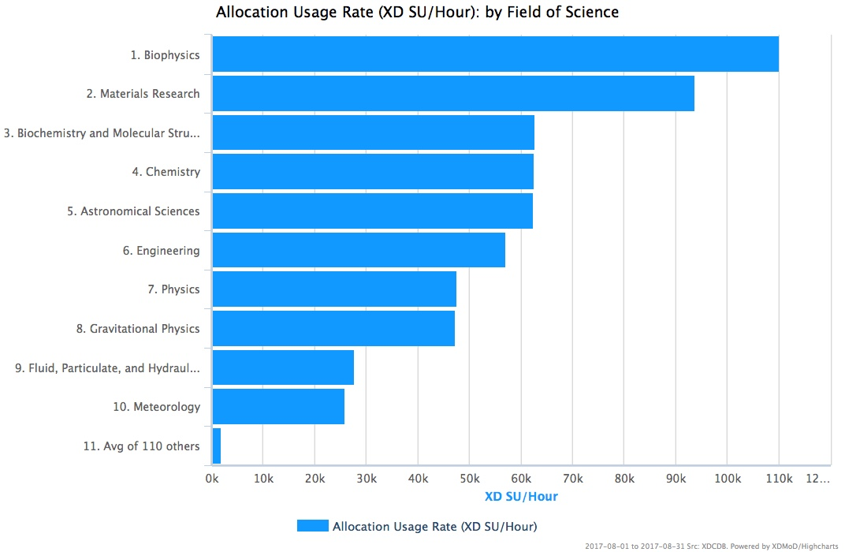
Data Generation on HPC Systems
From: https://xdmod.ccr.buffalo.edu

Slide 3
The Cost of Data Movement
Floating point operations will further increase
Speed to move data down the memory hierarchy is stagnant
Peak FLOPS
Peak PFS I/O Bandwidth

Slide 4
Programming Models Evolve
Y over ( MPI + X )
From John Barr (2013)
https://www.scientific-computing.com/news/analysis-opinion/software-development-standards-next-generation-hpc-systems

Slide 5
Programming Models Evolve
Y over ( MPI + X )
X: C / Fortran
OpenMP
OpenACC
UPC
CUDA
….
From John Barr (2013)
https://www.scientific-computing.com/news/analysis-opinion/software-development-standards-next-generation-hpc-systems

Slide 6
Programming Models Evolve
Y over ( MPI + X )
Y: MapReduce
In situ analysis
In transit analysis
….
X: C / Fortran
OpenMP
OpenACC
UPC
CUDA
….
From John Barr (2013)
https://www.scientific-computing.com/news/analysis-opinion/software-development-standards-next-generation-hpc-systems

Slide 7
Canonical MapReduce
MapReduce runtime handles the parallel job execution, communication, and data movement
Users provide map and reduce functions
Wordcount example:
<Hello,1>
Hello
World
<world,1>
reduce
<Hello, 2>
map
Shuffle
Hello
World
map
reduce
<World, 2>
<Hello,1>
<world,1>
7

Slide 8
over MPI
Is MapReduce an appealing way to handle big data processing on HPC systems?
8

Slide 9
Data Processing on HPC Systems
Key differences between Cloud computing and HPC systems disenfranchise the naïve used of Cloud method
Cloud computing systems
HPC systems
disk
processor
processor
Interconnect
Ethernet
processor
disk
array
disk
MPI/OpenMP
Hadoop/Spark

Slide 10
MR-MPI Implementation
Support logical map-shuffle-reduce workflow in four phases:
Map, aggregate, convert, and reduce [1]
input
<key, value>
<key, value>
<key, list<value>>
output
P0
aggregate
convert
reduce
map
P1
map
convert
reduce
…
…
…
…
…
Pn
map
convert
reduce
barrier
barrier
barrier
barrier
[1] S. J Plimpton and K. D. Devine. MapReduce in MPI for Large-Scale Graph Algorithms. Parallel Computing, 37(9):610–632, 2011.

Slide 11
MR-MPI Implementation
Allocation additional memory buffers for metadata → Cost: extra memory use
If in-memory buffer full → Spill data to the disk → Cost: poor data management
staging area
staging area
send buffer
receive buffer
P0
map
Static
Allocation
receive buffer
P1
map

Slide 12
MR-MPI Implementation
Allocation additional memory buffers for metadata → Cost: extra memory use
If in-memory buffer full → Spill data to the disk → Cost: poor data management
staging area
staging area
send buffer
receive buffer
P0
map
Static
Allocation
send buffer
receive buffer
P1
map

Slide 13
MR-MPI Implementation
Allocation additional memory buffers for metadata → Cost: extra memory use
If in-memory buffer full → Spill data to the disk → Cost: poor data management
staging area
staging area
send buffer
receive buffer
P0
map
Static
Allocation
send buffer
receive buffer
P1
map

Slide 14
MR-MPI Implementation
Allocation additional memory buffers for metadata → Cost: extra memory use
If in-memory buffer full → Spill data to the disk → Cost: poor data management
staging area
staging area
send buffer
receive buffer
P0
map
Static
Allocation
send buffer
receive buffer
P1
map

Slide 15
MR-MPI Implementation
Allocation additional memory buffers for metadata → Cost: extra memory use
If in-memory buffer full → Spill data to the disk → Cost: poor data management
staging area
staging area
send buffer
receive buffer
P0
map
Static
Allocation
send buffer
receive buffer
P1
map

Slide 16
MR-MPI Implementation
Allocation additional memory buffers for metadata → Cost: extra memory use
If in-memory buffer full → Spill data to the disk → Cost: poor data management
staging area
staging area
send buffer
receive buffer
P0
map
Static
Allocation
send buffer
receive buffer
P1
map

Slide 17
Mimir Implementation
Interleave operations: e.g., map interleaves with aggregate
interleave
input
<key, value>
<key,value>
<key,list<value>>
output
P0
aggregate
convert
reduce
map
P1
map
convert
reduce
…
…
…
…
…
Pn
map
convert
reduce
barrier
barrier
barrier
[1] T. Gao, Y. Guo, B. Zhang, P. Cicotti, Y. Lu, P. Balaji, and M. Taufer. Mimir: Memory-Efficient and Scalable MapReduce for Large Supercomputing Systems. In Proceedings of the IPDPS, 2017.

Slide 18
Mimir Implementation
Use send buffer as output of map directly → Benefit: avoid extra buffers usage
Use KV/KMV container as staging area → Benefit: Dynamically allocate one or multiple pages
receive buffer
KV container
send buffer
P0
map
map
[1] T. Gao, Y. Guo, B. Zhang, P. Cicotti, Y. Lu, P. Balaji, and M. Taufer. Mimir: Memory-Efficient and Scalable MapReduce for Large Supercomputing Systems. In Proceedings of the IPDPS, 2017.

Slide 19
Mimir Implementation
Use send buffer as output of map directly → Benefit: avoid extra buffers usage
Use KV/KMV container as staging area → Benefit: Dynamically allocate one or multiple pages
receive buffer
KV container
send buffer
P0
map
map
[1] T. Gao, Y. Guo, B. Zhang, P. Cicotti, Y. Lu, P. Balaji, and M. Taufer. Mimir: Memory-Efficient and Scalable MapReduce for Large Supercomputing Systems. In Proceedings of the IPDPS, 2017.

Slide 20
Mimir Implementation
Use send buffer as output of map directly → Benefit: avoid extra buffers usage
Use KV/KMV container as staging area → Benefit: Dynamically allocate one or multiple pages
receive buffer
KV container
send buffer
Dynamic
Allocation
P0
map
map
[1] T. Gao, Y. Guo, B. Zhang, P. Cicotti, Y. Lu, P. Balaji, and M. Taufer. Mimir: Memory-Efficient and Scalable MapReduce for Large Supercomputing Systems. In Proceedings of the IPDPS, 2017.

Slide 21
Mimir Implementation
Use send buffer as output of map directly → Benefit: avoid extra buffers usage
Use KV/KMV container as staging area → Benefit: Dynamically allocate one or multiple pages
receive buffer
KV container
send buffer
Dynamic
Allocation
Improvements:
Avoid extra memory buffer usage
Manage intermediate data more efficiently
P0
map
map
[1] T. Gao, Y. Guo, B. Zhang, P. Cicotti, Y. Lu, P. Balaji, and M. Taufer. Mimir: Memory-Efficient and Scalable MapReduce for Large Supercomputing Systems. In Proceedings of the IPDPS, 2017.

Slide 22
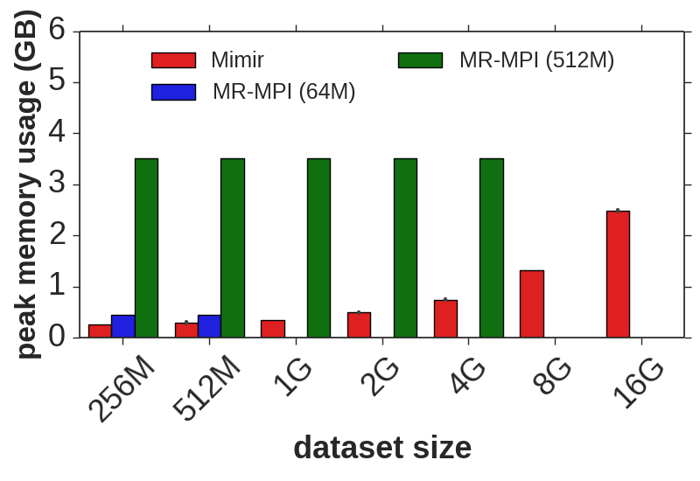
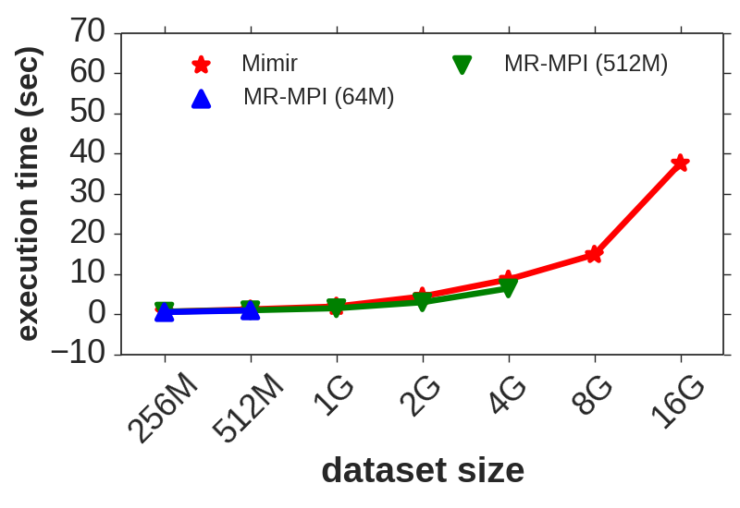
Results: WordCount
Benchmarks: WordCount (WC) – single-pass MapReduce application with associative and commutative reduce function; Datasets - Wikipedia dataset
HPC System: Tianhe-2: compute node with two Intel Xeon E2-2692v2 CPUs (12 cores each, 24 cores total) running at 2.2 GHz. Each node has 64 GB of memory
Settings: MR-MPI (64M page and 512M page); Mimir (64M page)
4X
64X
22
[1] T. Gao, Y. Guo, B. Zhang, P. Cicotti, Y. Lu, P. Balaji, and M. Taufer. Mimir: Memory-Efficient and Scalable MapReduce for Large Supercomputing Systems. In Proceedings of the IPDPS, 2017.

Slide 23
Data Load Imbalance
<key,value> pairs are NOT distributed evenly among processes
Imbalanced <key,value> pairs may cause poor resource usage
Mimir
Mimir
Number of <key,value> pairs for the WordCount (Wikipedia) on 768 processes
Balance ratio
Total time (sec)
Number of <key,value> pairs
Process ids
Balance ratio (Max mem / min mem for all processes) for WordCount (Wikipedia) on Tianhe-2
Execution time of WordCount (Wikipedia) with Mimir on Tianhe-2 without load balancing
23

Slide 24
Combining <key,value> Pairs
Merge <key,value> pairs with the same key before shuffle
Merge <key,value> pairs with the same key after shuffle
Wordcount example:
Hello
World
Hi
World
<Hello,1>
<World,1>
reduce
<Hello, 3>
map
<World,2>
<Hello,2>
<Hi,1>
<World,1>
Hello
World
Shuffle
<Hello,1>
map
reduce
<World, 3>
<World,1>
Hello
reduce
<Hi, 1>
map
<Hello,1>

Slide 25
Combining <key,value> Pairs
Combiner operations:
Merge <key,value> pairs with the same key before shuffle
Merge <key,value> pairs with the same key after shuffle
Application dependent:
Wordcount → YES
Join → NO
<key, value>
input
P0
aggregate
map
combine
combine
P1
map
…
…
combine
combine
Pn
map
combine
combine
25

Slide 26
From Multiple <key,value> Pairs With Same Key
send buffer
receive buffer
KVs
Process 0
copy
input elements
User-defined
map
…..
MPI_Alltoallv
communication
KVs
Process 1
copy
input elements
User-defined
map
…..

Slide 27
To Combined <key,value> Pairs
combine
send buffer
receive buffer
combine
KVs
Process 0
copy
input elements
User-defined
map
…..
MPI_Alltoallv
communication
combine
combine
KVs
Process 1
copy
input elements
User-defined
map
…..

Slide 28
Results: Word Counting
Benchmarks: WordCount (WC) – single-pass MapReduce application with associative and commutative reduce function
HPC System: Tianhe-2: compute node with two Intel Xeon E2-2692v2 CPUs (12 cores each, 24 cores total) running at 2.2 GHz. Each node has 64 GB of memory
Dataset: Synthetic words distributed in a balanced way (24 GB/node)

Slide 29
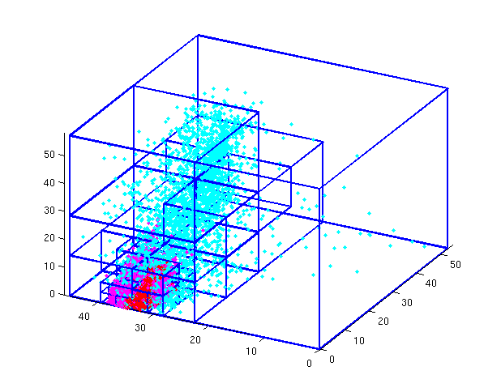
Results: Octree Clustering
Benchmark: Octree Clustering (OC) – iterative chain of MR jobs
HPC System: Tianhe-2: compute node with two Intel Xeon
E2-2692v2 CPUs (12 cores each, 24 cores total) running at
2.2 GHz. Each node has 64 GB of memory
Data: synthetic point distributed in a balanced way (2²⁹ points/node)

Slide 30
Lessons Learned
We present an extension of Mimir (a MapReduce over MPI framework) to support the combiner workflow
Leverages features of MapReduce applications with associativity and commutativity properties
Integrate our combiner workflow into Mimir
Reduce the memory requirement up to 59%
Reduce execution time up to 61%
Opensource software:
Mimir: https://github.com/TauferLab/Mimir.git

